Slide 1

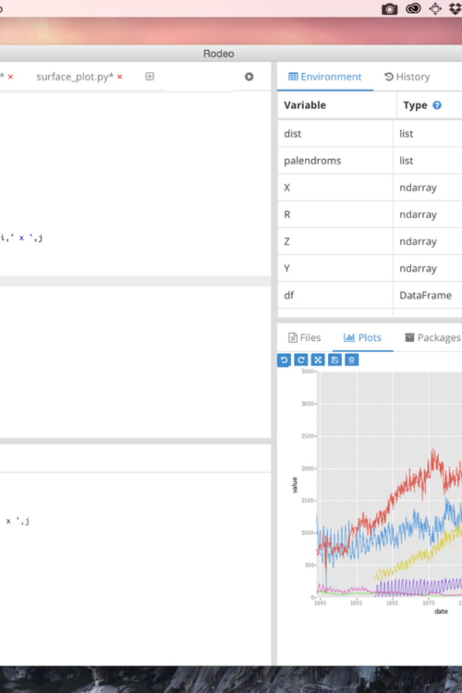


Introduction to Exploratory Data Analysis
Exploratory data analysis (EDA) is an essential step in understanding the characteristics of a dataset. It involves summarizing the main characteristics, often with visual methods, and uncovering patterns, anomalies, and relationships.
by Elly Muigo

Slide 2
Importing and Loading Data in Python
Efficient Data Import
Data Loading Methods
Python provides various libraries such as pandas for importing data efficiently from different sources like CSV, Excel, databases, etc.
Understanding different methods to load data into Python, including reading from local files, URLs, and databases, is crucial for EDA.

Slide 3
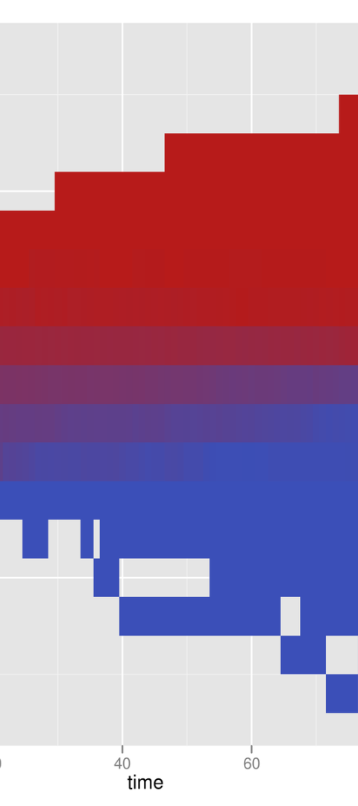
Understanding the Structure of the Dataset
1
Data Dimensions
2
Data Types and Attributes
Investigating the number of rows and columns in the dataset to understand the size and shape of the data.
Exploring the different data types and attributes present in the dataset, such as numerical, categorical, and datetime values.

Slide 4
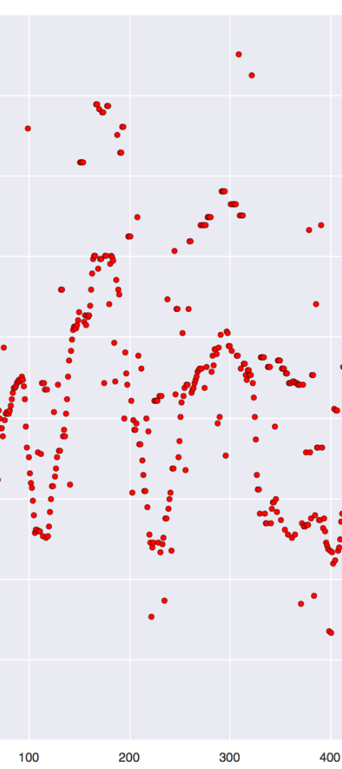
Handling Missing Values and Outliers
1
Missing Values
Identifying and handling missing data through imputation or removal to avoid biased analysis.
2
Outlier Detection
Detecting and addressing outliers that can significantly impact the statistical measures and models.

Slide 5

Visualizing Data Using Plots and Charts
Types of Plots
Visual Encoding
Exploring a variety of plots such as histograms, scatter plots, bar plots, and box plots to visualize different aspects of the data.
Understanding how to employ visual attributes like color, shape, and size to effectively represent data relationships.

Slide 6
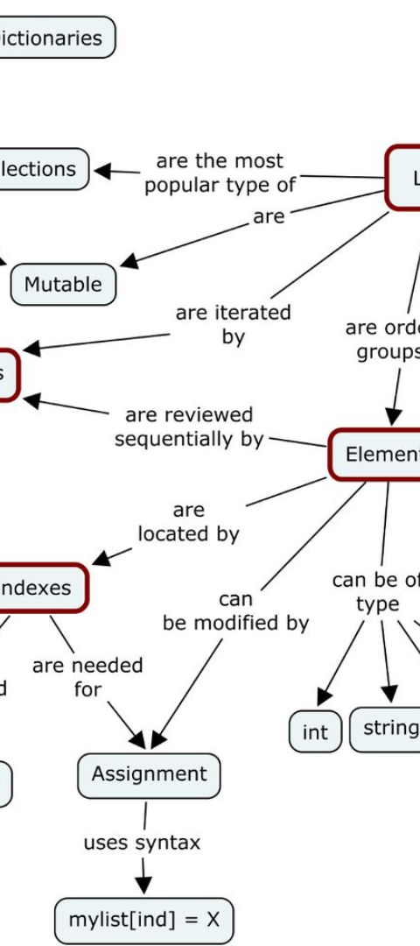


Exploring Relationships Between Variables
Correlation Analysis
Assessing the strength and direction of relationships between variables using correlation measures.
Association Rules
Exploring association rules to identify interesting patterns and relationships between different variables.

Slide 7
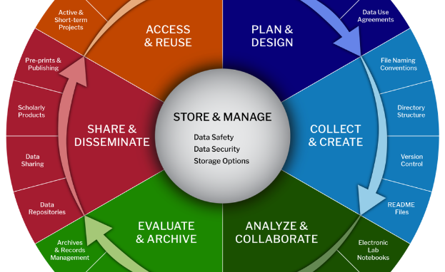

Feature Engineering and Data Transformation
Feature Creation
Data Transformation Techniques
Generating new features from existing variables to enhance the predictive power of machine learning models.
Discussing techniques like normalization, encoding, and scaling to prepare the data for modeling and analysis.

Slide 8
Summary and Conclusions
Key Findings
Summarizing the main insights and discoveries from the exploratory data analysis process.
Next Steps
Outlining the potential next steps such as modeling, hypothesis testing, or further data collection.

